Slide 1
BIZ06 – Bahasa Inggris 2

Slide 2
UNIT 1 Welcome to our company
Meeting 1

Slide 3
Specific Competence
Students are able to welcome a visitor in business situation, use the language to ask questions and describe things (C3)

Slide 4


Reference
Ancol Students Serpong Students

Slide 5
1. Present Tenses

Slide 6
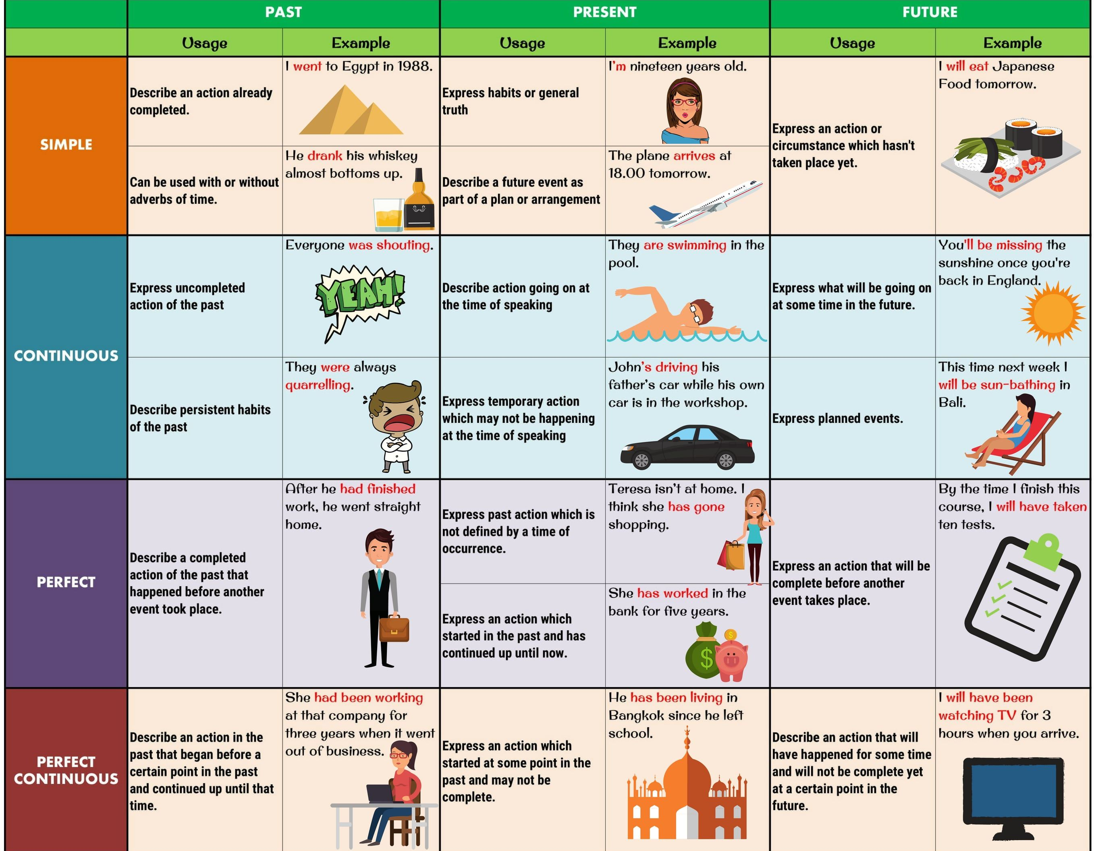
1.1 Present Simple
There are a lot of tenses in English.
However, today we are going to focus on Present Simple Tense dan Present Simple Continuous

Slide 7
1.1 Present Simple
The present simple tense is used to talk about something that happens usually or often.
Ly works with me in the sales department.
Irfan writes a report every time he attends the meeting.
Robert comes from London and he loves there with his family.

Slide 8
1.1 Present Simple
There are two forms of Present simple tense. One is using “To be” and the other is using “Verb”.
Now pay attention on present simple tense which using “to be”

Slide 9
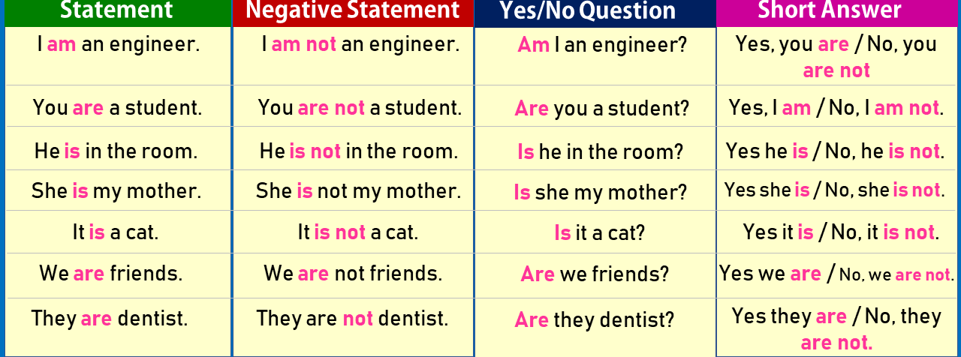
1.1 Present Simple
Present Simple “To Be” Simple: To Be

Slide 10
1.1 Present Simple
If you pay attention on those examples. To be in simple present tense is divided into three:
Am = for subject I
Is = for subject He, She, It (Singular)
Are = for subject You, We, They (Plural)
And they are followed by noun/adjective.

Slide 11
1.1 Present Simple
A noun names a person, place, things, or idea. For example: the weather, dog, cat, horse, student, teacher, Kevin, apple, etc.
An adjective describes a noun/pronoun. For instance: red, blue, tall heavy, crowded, difficult, beautiful,

Slide 12
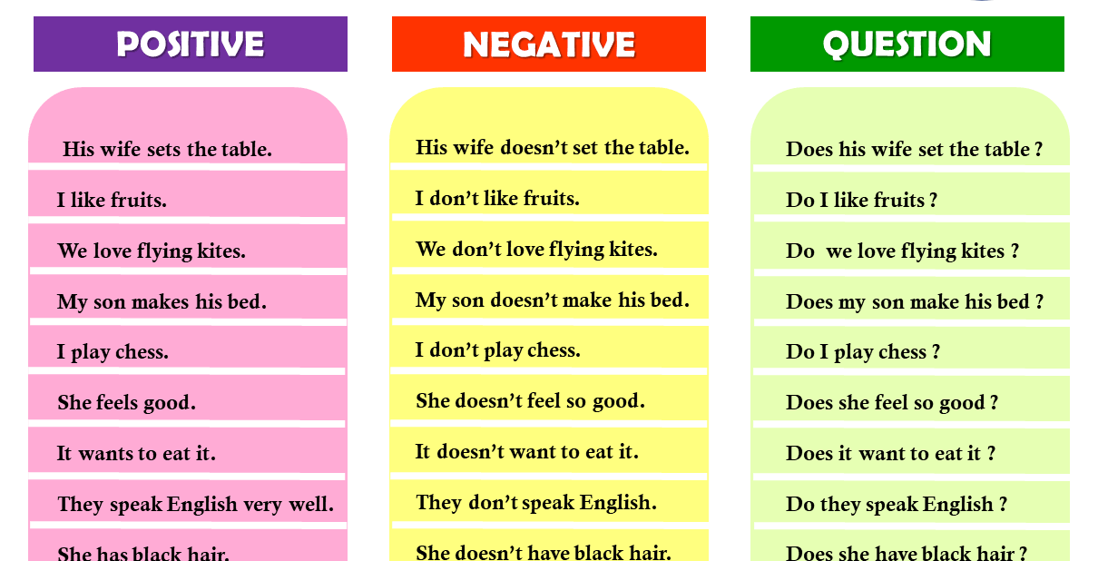
Present Simple: Verb
1.1 Present Simple
Present Simple: Verb

Slide 13
1.1 Present Simple
The simple present is just the base form of the verb. Questions are made with do and negative forms are made with do not.
Statement: You speak English.
Question: Do you speak English?
Negative: You do not speak English.
In the third person singular, -s or -es is added. Questions are made with does and negative forms are made with does not.
Statement: He speaks English.
Question: Does he speak English?
Negative: He does not speak English.

Slide 14
if a verb ends with the letter consonant + y
1.1 Present Simple
we take y out and add -ies at the end of the verb.
fly / flies; cry / cries; study / studies; apply / applies; bury / buries; carry / carries; copy / copies; dry / dries; fly / flies; fry / fries;
She studies her lessons every night.
He never dries his hair after a shower.
He tries to earn money.

Slide 15
if a verb ends with this letter vowel + y
1.1 Present Simple
we only add -s at the end of the verb.
pay / pays, buy / buys
enjoy / enjoys, play / plays
She never plays tennis.
Sally enjoys dancing.

Slide 16
1.1 Present Simple
There are some helpful hints to make you easier to recognize present simple. It is often used with the following words and phrases:
Always
Usually
Often
Sometimes
Rarely
Never
Every Monday/week/etc
Each Monday/week/ etc
Once/twice a week/month/etc
Three times a week/month/ec

Slide 17
Part I. Fill in the blank using present simple tense.
Practice 1
Peter and his friends __________ to school by bus. (go)
Elephants __________ leaves and grass. (eat)
David's father __________ in a hospital. (work)
The bank opens at 9.30 and __________ at 4.30. (close)
Tom and Jim __________ football every day after school. (play)
Mr. Jones is a teacher. He __________ History. (teach)
Our lessons __________ at 9.00 and __________ at 3.30. (start / finish)
My pen friend __________ in Japan. (live)
Mary and her brother __________ cartoons every Sunday morning. (watch)
John __________ his room every day. (tidy)
go
eat
works
closes
play
teaches
start
finish
lives
watch
tidies

Slide 18
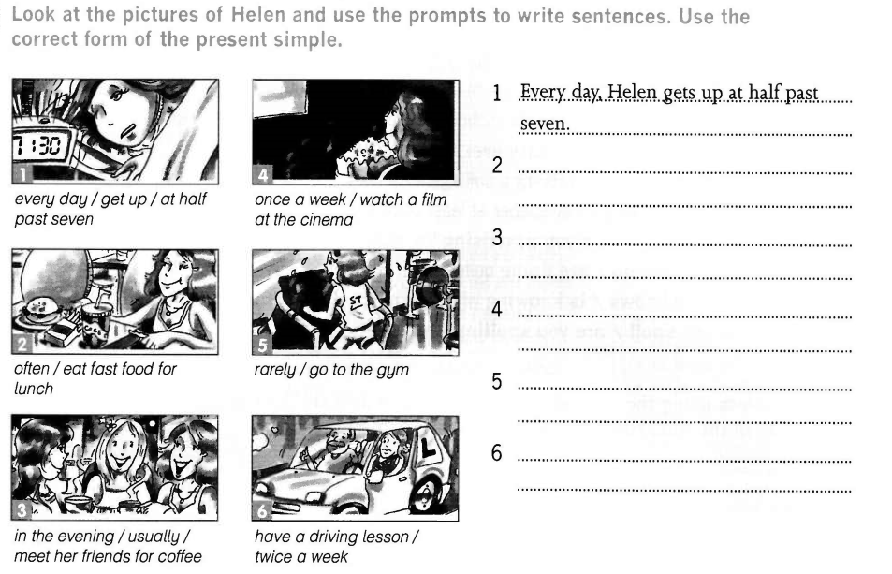
Practice 1

Slide 19
2. Present Continuous

Slide 20
2.1 Present Continuous
Present Continuous is used to show that an ongoing action is happening now, either at the moment of speech or now in a larger sense. The present continuous can also be used to show that an action is going to take place in the near future.

Slide 21
2.1 Present Continuous
The present continuous is formed using am/is/are + present participle. Questions are indicated by inverting the subject and am/is/are. Negatives are made with not.
Statement: You are watching TV.
Question: Are you watching TV?
Negative: You are not watching TV.

Slide 22
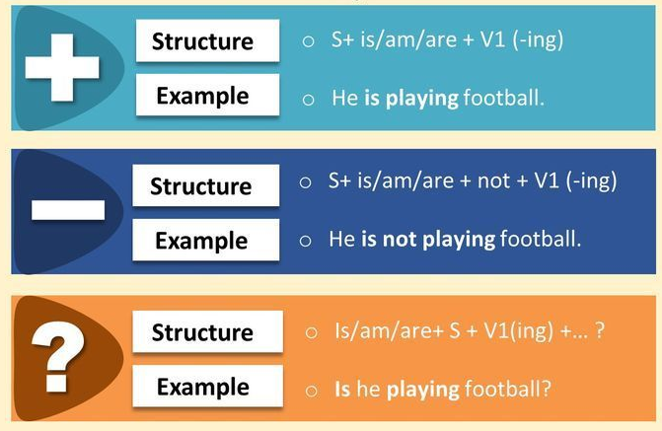
2.1 Present Continuous

Slide 23
2.1 Present Continuous
Use the present continuous with verbs to express the idea that something is happening now, at this very moment. It can also be used to show that something is not happening now.
Examples:
You are learning English now.
You are not swimming now.
Are you sleeping?
I am sitting.
I am not standing.

Slide 24
2.1 Present Continuous
Sometimes, speakers use the present continuous to indicate that something will or will not happen in the near future.
Examples:
I am meeting some friends after work.
I am not going to the party tonight.
Is he visiting his parents next weekend?
Isn't he coming with us tonight?

Slide 25
Did you know?
2.1 Present Continuous
We don’t use some verbs in the present continuous, for example: like, know, want, need, prefer, understand

Slide 26
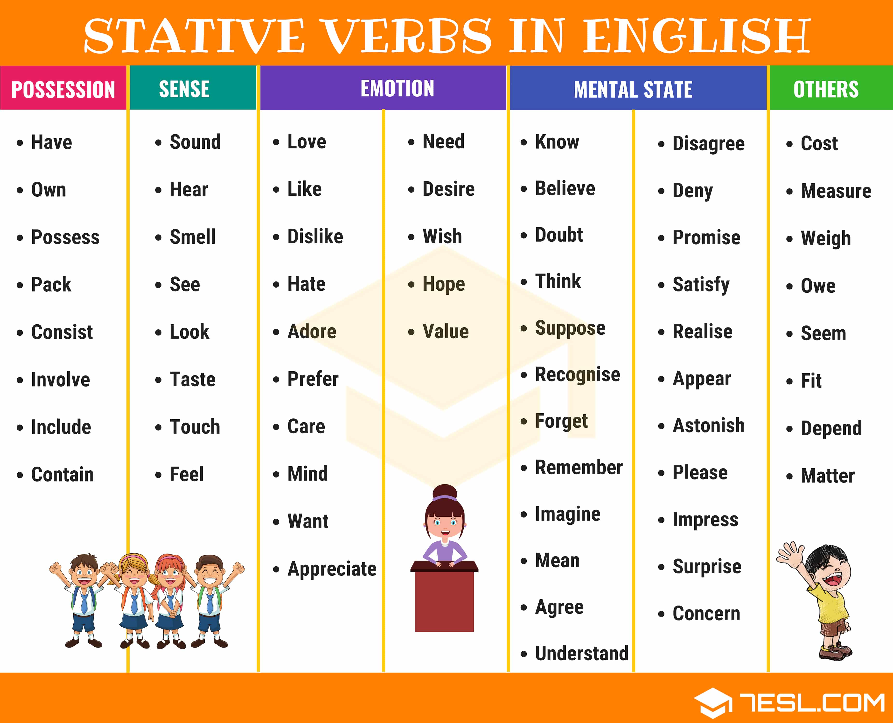
Other examples:
2.1 Present Continuous

Slide 27
Part II. Put in the present continuous form of the verb in brackets.
Practice 2
Please be quiet. I _______________ (try) to read my book.
I _______________ (not/use) the computer at the moment so you can use it.
Mary is ill so Sue _______________ (teach) her lessons today.
Excuse me, I _______________ (look) for a hotel. Is there one near here?
_______________ (you/wait) for someone?
Jack, you are very careless. You _______________ (always/forget) to do your homework!
The cost of living _______________ (rise) very fast. Every year things are more expensive.
What _______________ (you/do)? I _______________ (clean) my shoes.
Why _______________ (not/wear) shorts? It's so hot today.
The neighbours are so noisy! They _______________ (always/argue) loudly.
am trying
am not using
is teaching
am looking
are you waiting
are always forgetting
is rising
are you doing
am cleaning
aren’t you wearing
are always arguing

Slide 28
Practice 2
Part II. Put the verb in brackets into the present simple or the present continuous.
She always ______ (remember) my birthday.
Mr. Brown ______ (work) in a supermarket.
I ______ (work) in this factory until I find a better job.
Look! It ______ (snow).
Can you hear those girls? What ______ (they/talk) about?
______ (you/know) Helen?
We ______ (never/go) to work by tube. It is too busy.
When I'm in Paris I ______ (usually/stay) in the Hotel du Pont, but this time I ______ (stay) in the more expensive Hotel Notre Dame.
______ (you/believe) in ghosts?
My parents ______ (live) in Sydney. Where ______ (your parents/live)

Slide 29
3. Wh-questions

Slide 30
3.1 Wh-questions
Wh-questions begin with what, when, where, who, whom, which, whose, why and how. We use them to ask for information. The answer cannot be yes or no:
A: do you finish college?
B: Next year.
A: is your favorite actor?
B: George Clooney for sure!

Slide 31
Forming wh-questions: With an auxiliary verb
3.1 Wh-questions
We usually form wh-questions with:
wh- + an auxiliary verb + subject + main verb?
Or
wh- + a modal verb + subject + main verb?
Note:
Auxiliary verbs: be, do, have
Modal verb: will, can, would

Slide 32
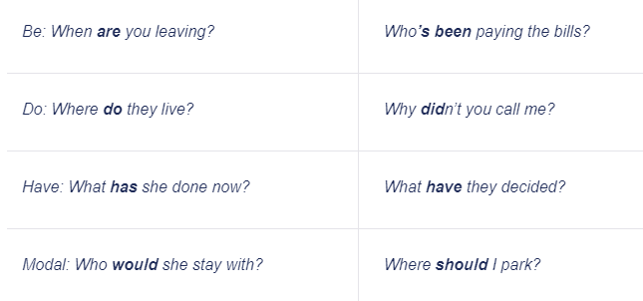
3.1 Wh-questions
Here are the examples:

Slide 33
Forming wh-questions: Without an auxiliary verb
3.1 Wh-questions
When what, who, which or whose is the subject or part of the subject, we do not use the auxiliary. We use the word order subject + verb:
what fell off the wall?
which horse won?
who bought this?
whose phone rang?

Slide 34
3.1 Wh-questions
Pay attention!
These sentences show the difference:
Who owns this bag? | Who is the subject of the sentence and this bag is the object. We use no auxiliary verb.
Who do you love most? | Who is the object of the sentence and you is the subject. We use the auxiliary verb do.
Hi, if you want to find additional information, you may go to https://dictionary.cambridge.org/grammar/british-grammar/questions-wh-questions

Slide 35
Practice 3
Make WH-questions with the highlighted words as the answers.
They study (English) every Tuesday morning.
Romi goes to school (by bus)
The teacher explains the lesson (in front of the class).
(My brother) does his homework carefully.
My daughter always washes her hair (twice a week)
John loves eating (pizza).
Fenny invites (Bimo) to come to her birthday party.
Olga sings a song (beautifully).
Shanti gets up (at five).
Harry doesn't go to school (because he is sick).

Slide 36
4. Vocabulary

Slide 37
Practice 4
Part I. Match the number 1-6 with the definitions A-F
Open Page 4 to answer the questions in Part A.

Slide 38
Practice 4
Part II. Fill in the blanks with the words provided.
Open page 6 to answer the questions.
Vocabulary
Traffic jam | Job interview | Share | Public transportation
Commutes | Enormous | Schedule | Sales conference

Slide 39
5. Listening Activity

Slide 40

Practice 5
Play the audio file no. 2 on page 4 to fill in the blanks
Play the audio file no. 3 on page 8 to fill in the blanks.

